Slide 1
XIII International Risk Management Conference
YOUR CAT DOES NOT NEED TO BE A DISASTER
PRESENTATION BY BEV FITZGERALD
MANAGING DIRECTOR
FITZGERALD CONSULTING
ALMATY, KAZAKHSTAN – APRIL 2017

Slide 2
XIII International Risk Management Conference
CATASTROPHE (CAT) CLAIMS
Since the company’s inception, we have worked on numerous such catastrophe events, including –
9/11 Terrorist attack – New York Floods – NE England
Hurricanes Wilma, Emily and Stan – Mexico Earthquake – L’Aquila, Italy
Hurricane Ivan – Grand Cayman Earthquake - Chile
Hurricane Ike – Texas Earthquake – New Zealand
Explosion – Buncefield, UK Floods - Canada
7/7 Terrorist attack – London Earthquake – Ecuador
Floods - Thailand
For our work in Chile, FitzGerald Consulting won a prestigious British Insurance Award – Major Loss category.

Slide 3
XIII International Risk Management Conference
‘What’s the number’

Slide 4
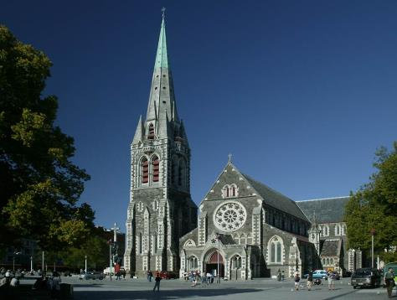
XIII International Risk Management Conference
Case study – New Zealand Earthquakes CAT 2010/11

Slide 5
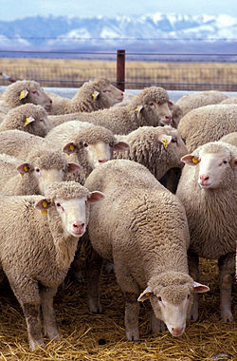
BACKGROUND DATA
Population of New Zealand 4.4m (people)
Population of New Zealand 30m (sheep)
Population of South Island 1.0m
Population of Christchurch 400k
Size of insured EQ losses $19 US billion
Size of overall EQ loss $40 US billion

Slide 6
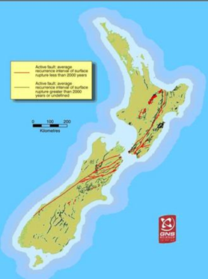
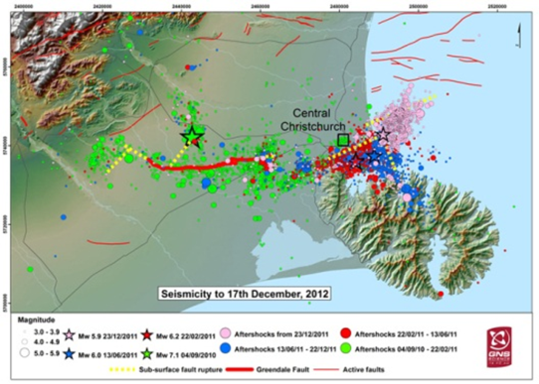
BACKGROUND – NEW ZEALAND SEISMICITY – CANTERBURY EARTHQUAKE SEQUENCE

Slide 7
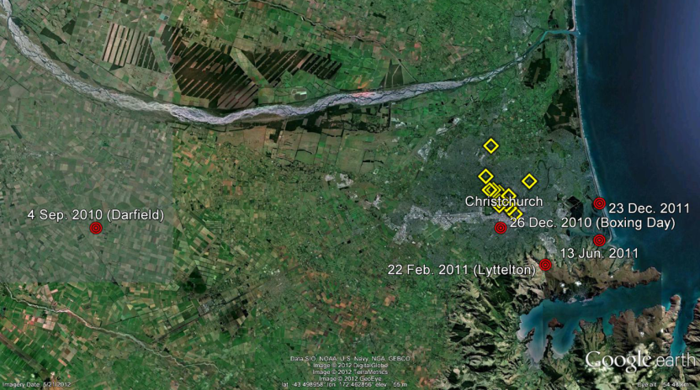
BACKGROUND - LOCATION OF EPICENTRES

Slide 8
MAIN EQ EVENTS
Earthquake | Magnitude (ML) | Depth (km) | Distance (km)
4 Sep 2010 | 7.1 | 10 | 40 W
26 Dec 2010 | 4.9 | 5 | 3 W
22 Feb 2011 | 6.3 | 5 | 10 SE
13 June 2011 | 6.3 | 6 | 10 E
23 Dec 2011 | 6.0 | 7 | 10 E

Slide 9
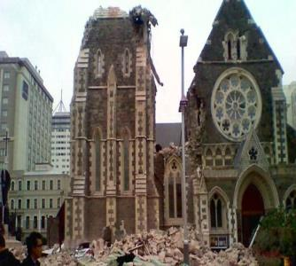
KEY NZ CAT ISSUES
Resourcing/Logistics
Allocation of Losses over Events
Code Upgrade/Seismic Strengthening
Coverage
EQC (Earthquake Commission)
Reinsurance

Slide 10
RESOURCING/LOGISTICS
Distance of NZ from main insurance centres - UK, Europe, US, Japan, Bermuda, Singapore etc
Time difference – UK/NZ often 12 hours
Overwhelmed – local NZ Claims operations, adjusting, engineers, quantity surveyors etc
Both in terms of pure numbers of people and also CAT/major loss experience

Slide 11
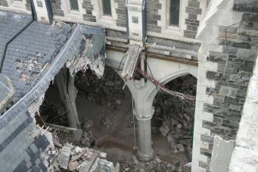
RESOURCING/LOGISTICS
Solution
Import Claims professionals to NZ
‘Front-end load’ overall Claims handling and individual major loss cases
NB – problems of bringing in external expertise – cultural issues; local knowledge; ‘revolving doors’ of people working on ‘rolling’ basis

Slide 12
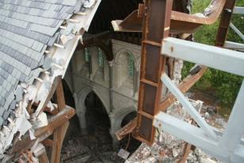
ALLOCATION
Five main events
Proper allocation to each essential
Especially where reinsurance programme covers different events/years
Also affects – number of deductibles; limits per event/year; ‘Reinstatement of Sum Insured’ clauses; Business Interruption losses

Slide 13
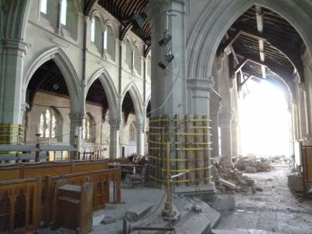
ALLOCATION
Solution
Deal with allocation issue on discrete basis – specialist team
Provide clear Guidelines to Claims personnel, adjusters, retained engineers etc
Ensure detailed, preferably contemporaneous recording of events

Slide 14
CODE UPGRADE/ SEISMIC STRENGTHENING
Flows from ‘Local Authority/Public Authority’ (Code Upgrade) clause in insurance policy
Pressures from Government; local Christchurch authorities; professional bodies, especially engineers
Significant potential extra costs
‘Future-proofing’ not covered by policies

Slide 15
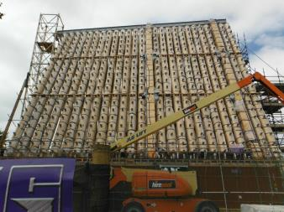
CODE UPGRADE/ SEISMIC STRENGTHENING
Solution
Obtain top-flight legal advice
Understand engineering issues and NZ legislation
Provide clear Guidelines to Claims personnel, adjusters, retained engineers etc
Maintain consistent stance

Slide 16
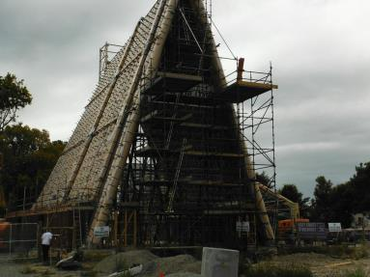
COVERAGE
Local NZ issues
No Average on commercial property policies
No sums insured on domestic (personal lines) policies

Slide 17
COVERAGE
EQ CAT specific issues –
Definition of policy limits – sums insured plus margin clause; plus demolition; plus professional fees; plus inflation etc
Reinstatement of Sums Insured clauses
Reinstatement v Indemnity

Slide 18
EQC (EARTHQAKE COMMISSION)
Acts as primary insurer for losses per event up to $100k NZ on Buildings claims
Handles these claims until $100k NZ ‘cap’ exceeded
Operational difficulties between insurers and EQC – e.g. quantum, allocation
What is ‘land’ and who insures it, if anyone?

Slide 19
REINSURANCE
Massive levels of reinsurance in NZ
Great reliance by cedants on smooth and prompt reimbursements
Reinsurers based throughout world
Often numerous different reinsurers on cedants’ overall programmes

Slide 20
REINSURANCE
Solution
Build high level of reinsurer confidence in cedants’ management of CAT
Ensure first-rate competence
Create excellent and continuous communications with reinsurers

Slide 21
KEY REASONS FOR PROLONGED CAT IN NZ
Government and Local Authority intervention
Earthquake Commission’s role
Multiple events and consequent large number of claims
Significant delay in proper resourcing – number and quality of adjusters/experts

Slide 22
KEY REASONS FOR PROLONGED CAT IN NZ - continued
Liquefaction and other adverse ground conditions
Unique ‘open-ended’ insurance policies – no limits
Maximising claims approach by policyholders – e.g. Code Upgrades; ‘Steel hardening’
‘Laid back’ social culture

Slide 23
RISKS FOR FUTURE CATS IN OTHER TERRITORIES BASED ON NZ EXPERIENCES
Government, Local Authority , ‘Heritage’ industry involvements
For example – areas cordoned off after EQ or terrorist bomb attacks (Christchurch City Centre cordoned off for 2.5 years after first EQ)
For example – retrospective legislation

Slide 24
RISKS FOR FUTURE CATS IN OTHER TERRITORIES BASED ON NZ EXPERIENCES - continued
Technical complexity of CAT incidents now – foundations: structural engineering; IT/Computerised processes – in factories, warehouses etc.
Application of Local Authority (Code Upgrade) clause in policies
Including ‘green’ (environmental) impacts
All likely to prolong CAT events

Slide 25
SOME POTENTIAL ADVERSE EFFECTS FOR INSURERS
Insurer/Reinsurer cash-flows
Increased BI claims
Negative impact on Claims handling resourcing
Much more difficult, entrenched policyholders – increase in settlement size

Slide 26
XIII International Risk Management Conference
Innovations in Claims Handling
AI (Artificial Intelligence)
Communications via new media
Block-chain (Shared Ledgers)
Enhanced Counter-Fraud Techniques
Drones

Slide 27
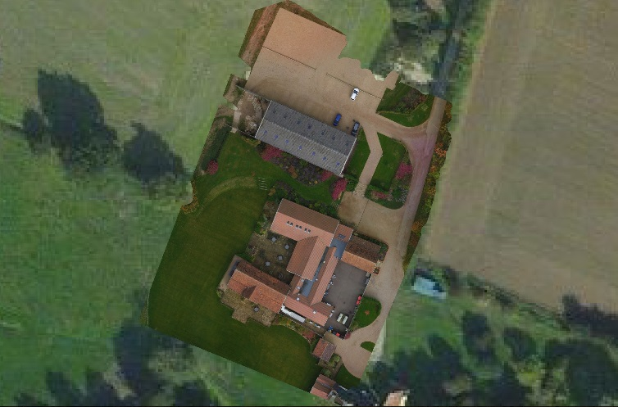
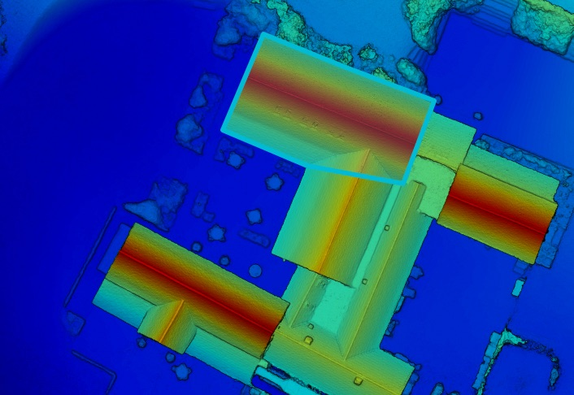
XIII International Risk Management Conference
Drones are an invaluable tool to the Insurance Industry. They give you the ability to access vantage points not previously accessible or safe. They provide endless opportunities for gathering accurate and detailed information about a claim.
Within a matter of hours, data can be fed back to claims handlers sitting on the other sides of the globe or to re-insurers keen to know what the extent of their liability is. Drones have the ability to stream live, highly detailed footage of a catastrophe via the web and produce 3D maps of sites, providing data like never before.

Slide 28
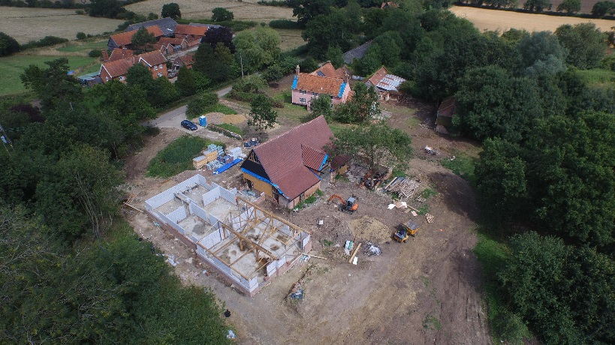
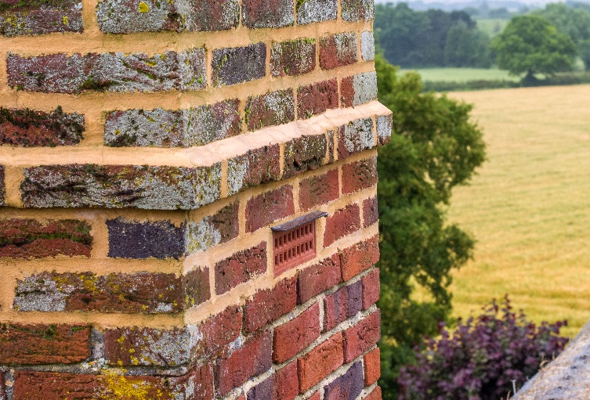
XIII International Risk Management Conference
Advantages of Drone Technology
Access areas previously impossible
Give a birds-eye view of a situation
High Resolution Still Photography and Video Footage
Geo-referenced 3D Mapping
Fast delivery of information (Live Streaming)
Perfect for Pre and Post Risk
Time-lapse Imagery
Cost effective compared with historic methods

Slide 29
XIII International Risk Management Conference THANK YOU Any questions?

Slide 30
CAT PLANNING FCL MENU OF SERVICES
Arriving as soon as possible at the scene of the CAT to support insurers/reinsurers in the immediate aftermath
Supporting insurers/reinsurers in the assessment of the overall reserve
Determining with insurers/reinsurers the key themes and issues coming out of the CAT – covering both Property Damage and Business Interruption
Carrying out further research on these legal, policy, technical issues
Working with insurers/reinsurers’ appointed lawyers to set out authoritative positions on these issues

Slide 31
CAT PLANNING FCL MENU OF SERVICES
Helping insurers/reinsurers to communicate these clearly to its Claims colleagues
Helping insurers/reinsurers to source particular experts, eg semi-conductor specialists; pollution/contamination experts; damage restoration etc.
Supporting insurers/reinsurers in communications with its reinsurers as necessary
Supporting insurers/reinsurers in internal communications with its senior management as required; helping create high-quality management packs (MI)

Slide 32
CAT PLANNING FCL MENU OF SERVICES
Helping insurers/reinsurers with communications with other stakeholders, eg loss adjusters; forensic accountants; external engineers
Assisting insurers/reinsurers with contract wordings with these external suppliers, if CAT terms have not already been agreed pre-CAT
Assessing the quality of adjuster performance on individual major losses
Depending on performance, assuming the role of Executive loss adjuster or co-adjuster on these cases

Slide 33
CAT PLANNING FCL MENU OF SERVICES
Being appointed by insurers/reinsurers as the actual loss adjuster (perhaps in conjunction with our local adjuster partner through the Context International global network)
Determining whether there are any recovery (subrogation) prospects
Initially pursuing these in conjunction with insurers/reinsurers’ appointed lawyers
Providing in-sourced senior and very experienced insurance market Claims managers/directors to add to insurers/reinsurers’ own resources if required

Slide 34
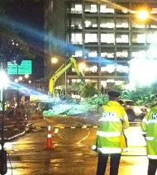
XIII International Risk Management Conference
FCL People – Major & Complex Loss Adjusting
Bev FitzGerald Paul McNamara
Gerald Williams Tom Griffiths
Graeme Shurben Nigel Greenhalgh
John Holland Phil Beadsmore
Roger Woodhead Steve Cliff

Slide 35
XIII International Risk Management Conference
FCL People – Additional Specialists
David Rogers - Legal
Peter Taylor - Fraud
Chris Netherton - Damage Restoration
Judith Little - Cyber & Data
Steve Davies - Construction
Echo Alfa - Drone Services

Slide 36
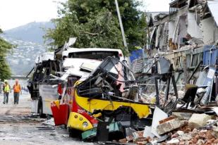
XIII International Risk Management Conference
FCL People – Claims Handling and Audit & Review
Clive Munnings Rob Sinclair
Martin Langhorst Peter Butler
Judith Little Allan Curphy
Joyce Wright

Slide 37
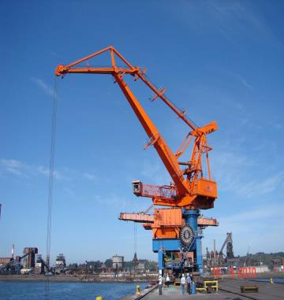
XIII International Risk Management Conference
FCL – Lines of Business
CAT Management
Property Damage Adjusting including Energy & Construction
Business Interruption
All Liabilities
DR – Specialist advice
Expert Witness
Audit & Review

Slide 38
XIII International Risk Management Conference
CATASTROPHE (CAT) CLAIMS
FitzGerald Consulting has built a very strong, world-wide reputation for supporting insurers, reinsurers and other involved parties in the management and handling of Catastrophe (CAT) claims.
We have multi-disciplinary teams of adjusters, Claims directors/managers and other specialists, such as engineers, accountants, surveyors, quantity surveyors, damage management experts and lawyers who can be mobilised at extremely short notice.

Slide 39
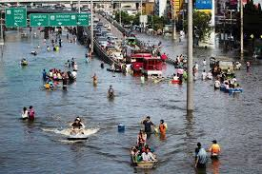
XIII International Risk Management Conference
FCL – Global Coverage
Part of Context International network –
40 Loss Adjusting Companies
300 Office network
50 Countries
FCL is sole UK representative
FCL also has its own businesses in Asia Pacific, based in New Zealand; in Latin America based in Chile; and a joint adjusting venture in Mexico

Slide 40
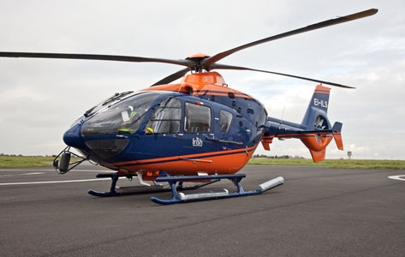
CONTACT
www.fitzgeraldconsulting.co.uk
Bev FitzGerald
bev@fitzgeraldconsulting.co.uk
Tel: 00 44 7815 810772

